Slide 1
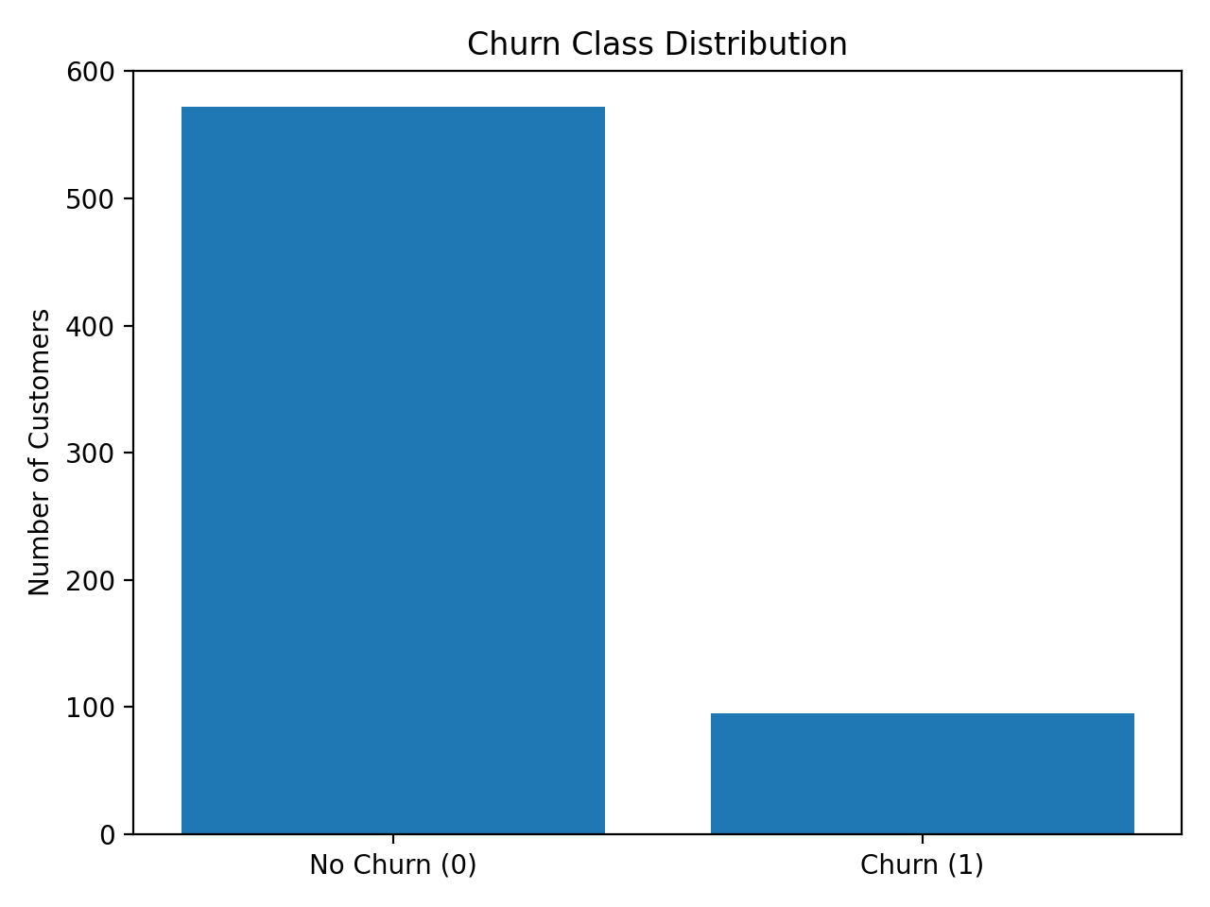
Feature Engineering (CRISP-DM: Data Preparation)
Goal: convert raw telecom activity into model-ready, customer-level features.
Key Steps:
• Binary encoding for Yes/No service plans
• One-hot encoding for categorical variables
• Standardization for numeric variables (for linear models)
• Leakage prevention via train-only fitting
Derived Behavioral Features:
• Total usage minutes
• International usage share
• Service calls intensity
Feature quality and behavioral design are more influential than algorithm choice alone.

Slide 2
Modeling Strategy & Evaluation Framework
01
Objective: Identify high-risk customers for targeted retention interventions.
Methodology:
• Train/Test split
• Cross-validation
• Out-of-sample validation
Evaluation Metrics:
• Recall (churn detection strength)
• Precision (cost control)
• F1 (balance)
• AUC (ranking quality)
In imbalanced churn settings, ranking ability (AUC) and recall are more important than raw accuracy.

Slide 3
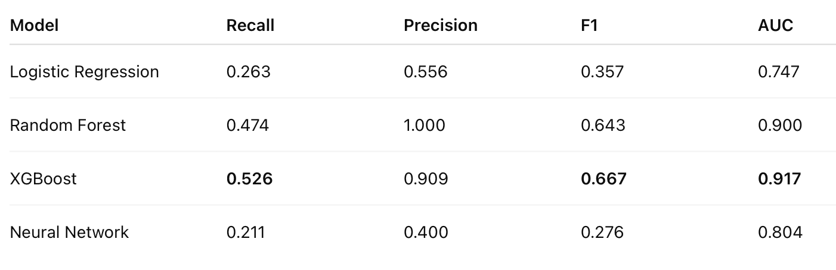
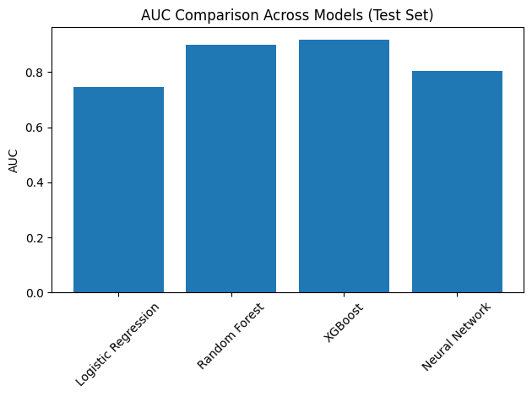
Model Comparison Summary
Key Observations:
• Ensemble models significantly outperform linear baseline
• XGBoost achieves strongest overall ranking performance
• Neural Network adds limited incremental value in structured tabular data

Slide 4
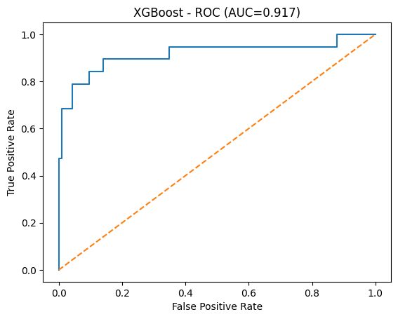
Best Model: XGBoost
Performance Highlights:
Accuracy = 0.925
Recall = 0.526
F1 = 0.667
AUC = 0.917
Executive Interpretation:
• Highest ranking ability across thresholds
• Strongest churn detection capability
• Balanced tradeoff between precision and recall
XGBoost best supports risk-based retention prioritization.

Slide 5
Threshold Strategy & Business Trade-Off
01
Management Decision Variable: Probability Threshold.
Lower Threshold → Higher Recall
Higher Threshold → Higher Precision
Strategic Choice:
• If retention budget is limited → prioritize precision
• If churn cost is high → prioritize recall
Recommended Approach:
Target top-risk percentile customers rather than fixed probability cutoff.
This aligns predictive ranking with real-world campaign deployment.

